Slide 1
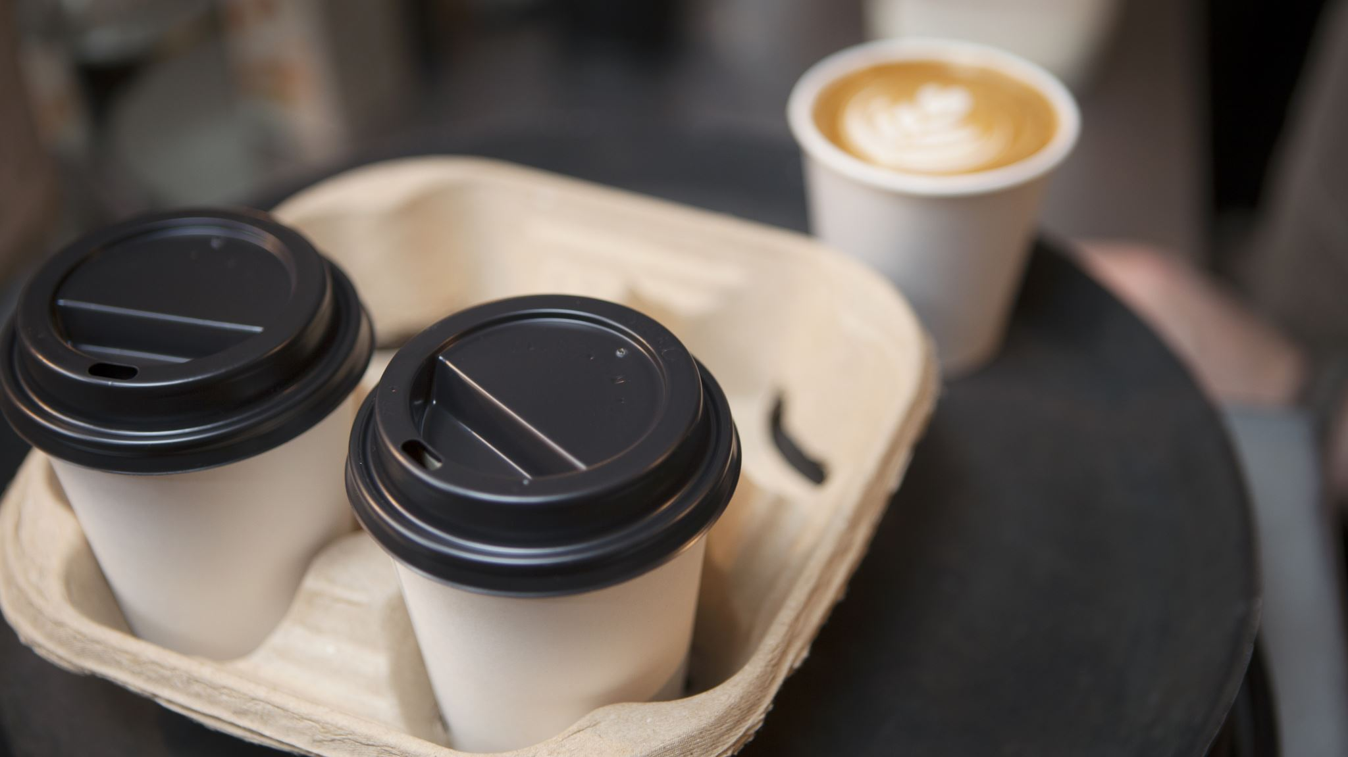
Energy Sans Calories: Comparing Starbucks Drinks
Bernard Wittmaack

Slide 2





America Runs on Coffee
*
Over 50% of Americans over 18 drink coffee daily.
*
Average coffee drinker consumes 3 cups (24 oz) everyday.
68 gallons per year
365 days
*
https://www.e-importz.com/coffee-statistics.php

Slide 3

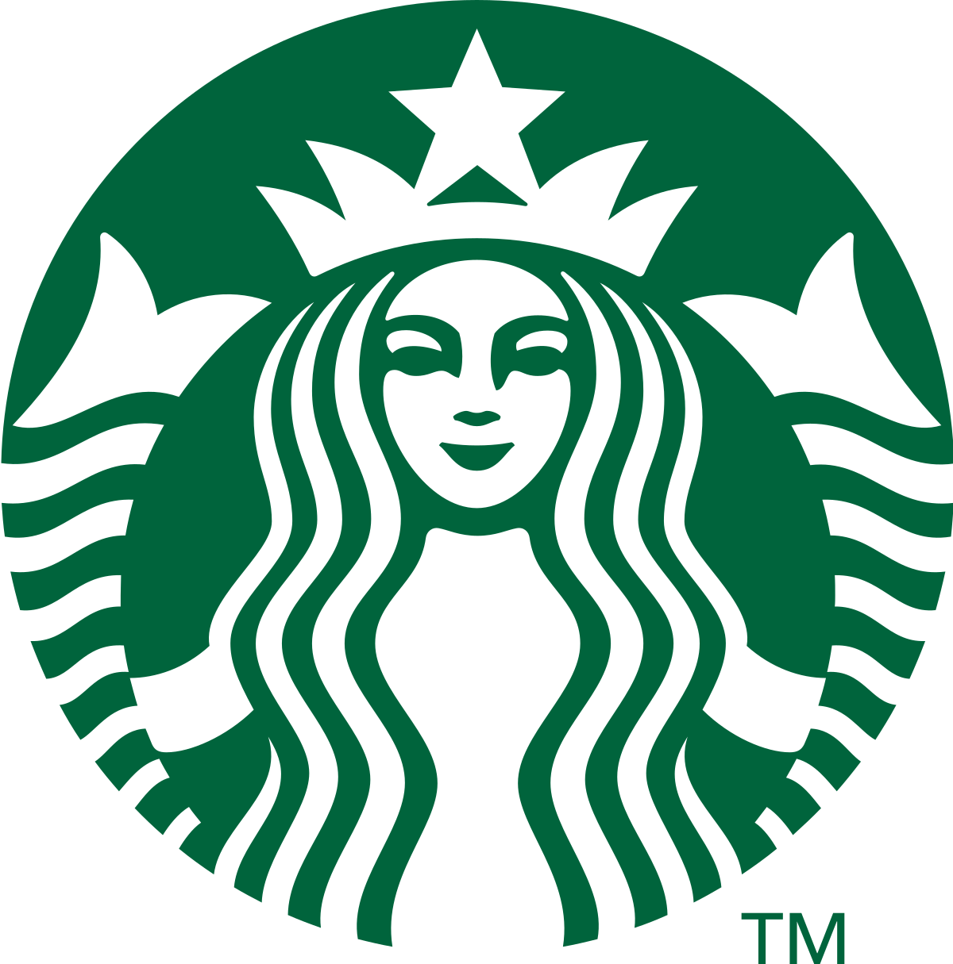


And Starbucks is Our Favorite Coffee Chain
18,354 stores in United States.
4 million coffee drinks per day sold.
60 million customers served each week.
https://www.reference.com/world-view/many-cups-coffee-starbucks-sell-day-30165505f1ced767
https://en.wikipedia.org/wiki/Starbucks

Slide 4
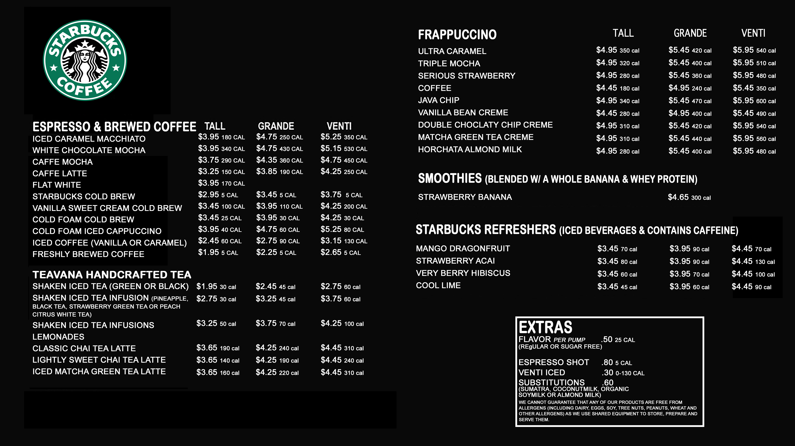
How to get your fix?
Starbucks has many coffee drink options and sizes.
Which ones are good for your mornings and your waistline?
Use data from Kaggle Nutrition facts for Starbucks Menu dataset (https://www.kaggle.com/starbucks/starbucks-menu) to answer questions.

Slide 5
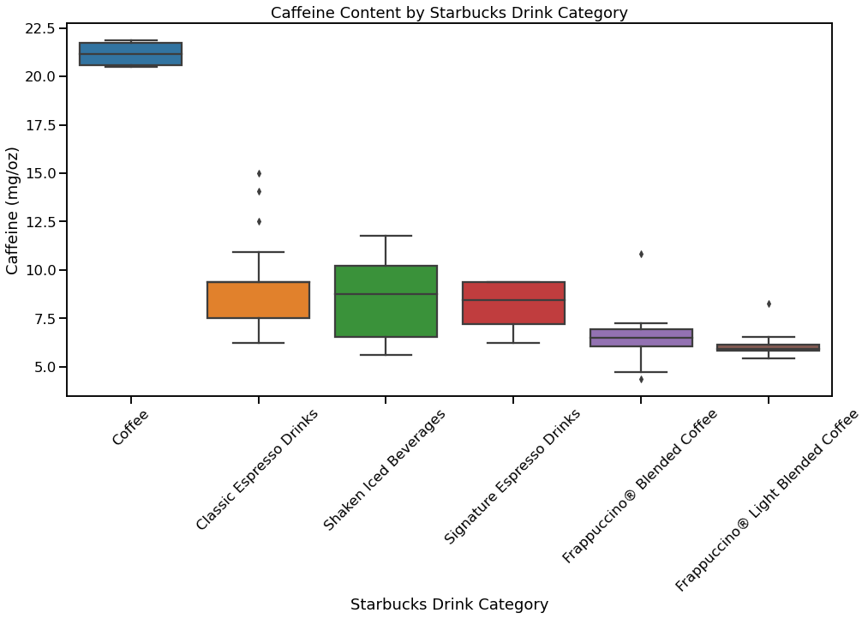

Want a Buzz? Get Plain Coffee!
Brewed coffee has 2.4x more caffeine per cup than Starbucks espresso, iced, or Frappuccino type drinks.

Slide 6
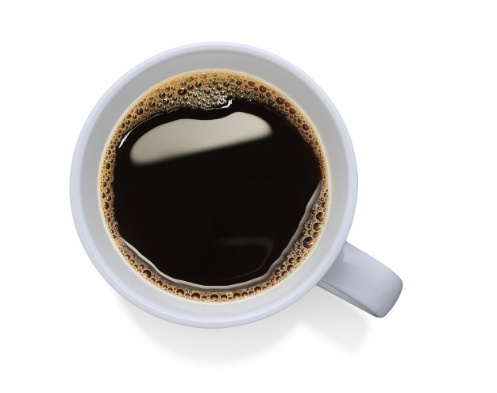
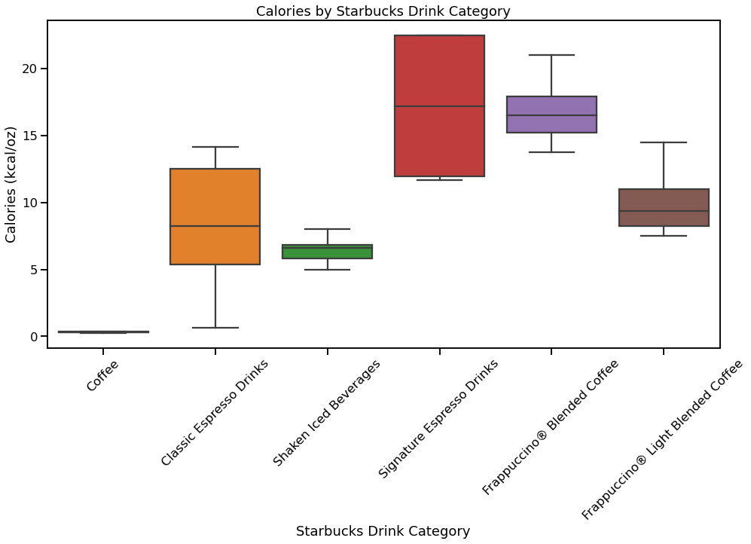
Plain Coffee Energizes Without the Calories
Brewed coffee has 3 kcal/cup.
Starbucks signature espresso drinks can have 180 kcal/cup.

Slide 7


217,000
Calories Annually
24 oz Starbucks signature espresso every day
595 Calories*
Per day
*1 pint of vanilla ice cream has 550 Calories

Slide 8
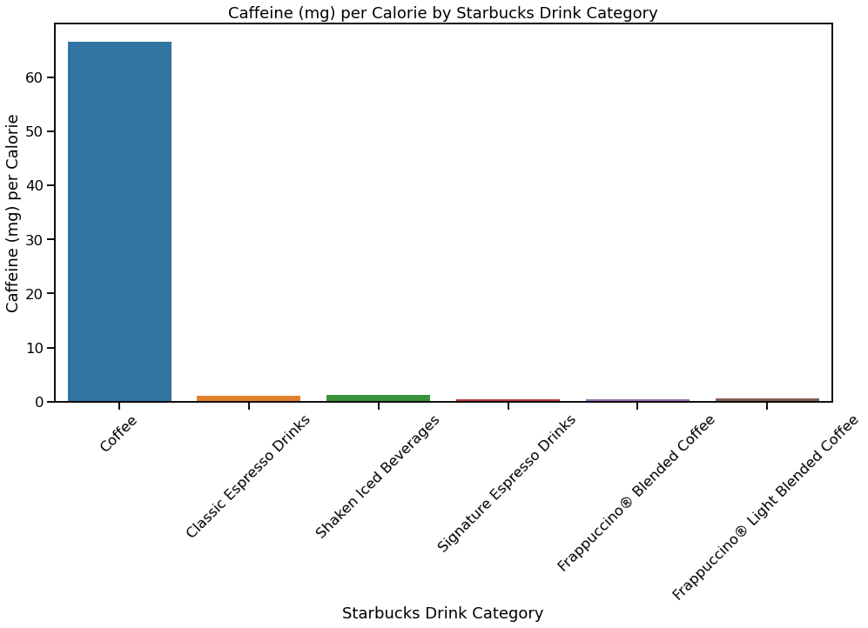
Brewed Coffee Provides 60X the Caffeine per Calorie than the other Starbucks Drinks

Slide 9
Summary
American coffee drinkers consume 3 cups a day on average.
Starbucks offers many options of coffee drinks.
Sugary drinks like Starbucks signature espressos are very caloric.
Brewed coffee provides by far the most caffeine per Calorie.

